Slide 1
STUDENT PORTFOLIO
STUDENT NAME: LAKSHMI.V
REGISTER NO :24132251802522026
NMID: asanm225anm22524132251802522026
DEPARTMENT: B.SC,COMPUTER SCIENCE
COLLEGE: GOVERNMENT ARTS &SCIENCE COLLAGE,VANUR/ANNAMALAI UNIVERSITY-CHITHAMBARAM(AFFILIATED COLLAGE)

Slide 2
PROJECT TITLE Creative Student portfolio using FWD

Slide 3


AGENDA
Problem Statement
Project Overview
End Users
Tools and Technologies
Portfolio design and Layout
Features and Functionality
Results and Screenshots
Conclusion
Github Link
3/21/2024 Annual Review

Slide 4

PROBLEM STATEMENT
1.Students cannot showcase their talents fully
Through Marksheets alone.
2.Archeivements remain scattered without a single platform.
3.Resumes fail to highlight creativity and real skills.
4.Lack of digital presence reduces student opportinities.
5.Teachers and recruiters struggle to see practical knowledge.
6.No easy way to show growth , goals , and personality together.
7.Missing a modern tool to a stand out in a competitive world.

Slide 5

PROJECT OVERVIEW
1.A student portfolio highlights personal details, skills, and achievements.
2.It brings together projects, academics, and extracurricular activities.
3.Serves as a creative record of growth and learning journey.
4.Helps teachers and recruiters understand the student beyond grades.
“A student portfolio is a creative way to showcase skills , acheivements , and learning
Journey.”

Slide 6

WHO ARE THE END USERS?
1.Students – to showcase their skills, acheivements, and goals.
2.Teachers – to evaluate student progress and guide them.
3.Recruiters/Employers – to identify talent and opportunities.
4.Peers/classmates – to collaborate and get inspiration
5.Acadamic Institutions – to access overall student growth

Slide 7

TOOLS AND TECHNIQUES
TOOLS:
1.HTML,CSS,JAVASCRIPT & -> for design structure
2.VS Code-> Coding and editing
3.MS Power Point/Word -> documentation & report
TECHNIQUES:
Responsive Design->works on mobile & desktop
Intractive elements->links, images, certificates
Organized structure->About, skills, projects, contact

Slide 8
PORTFOLIO DESIGN AND LAYOUT
1.Clean and creative look
2.Highlights skills, projects, and achievements
3.Uses images ,icons ,and simple visuals
4.Easy navigation for users
5.Header->Name, title, navigation menu
6.About me-> short intro + photo
7.Contact info ->Email ,Phone ,socials
8

Slide 9
FEATURES AND FUNCTIONALITY
1.Animated typing effect for introduction.
2.Floating glowing decorations for modern design.
3.Profile photo with animated circular border.
4.Smooth scroll navigation and nav bar.
5.Contact form(with validation).
6.Responsive design for all devices.
7.Project showcase with images/details.

Slide 10
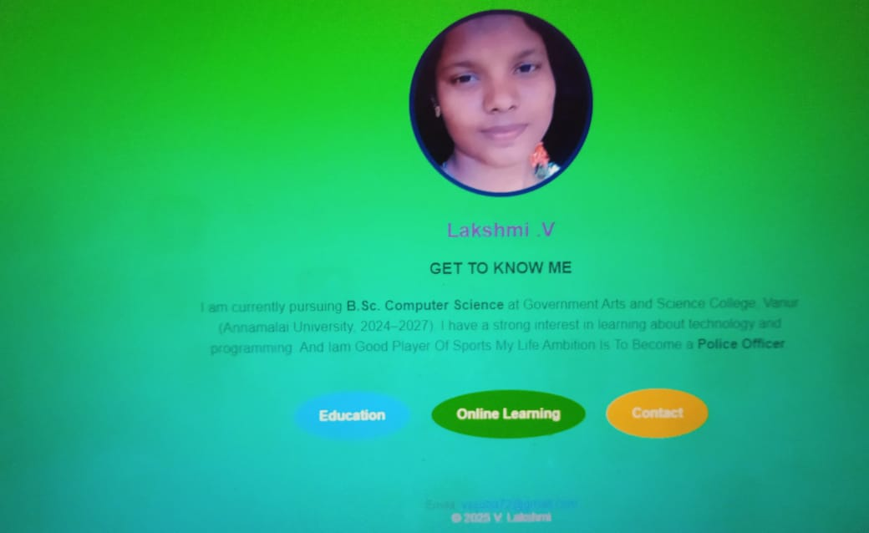

RESULTS AND SCREENSHOTS
3/21/2024 Annual Review
10

Slide 11
GITHUB
file:///C:/Users/home/Desktop/lakshmi.index.html

Slide 12
CONCLUSION
SUMMARIZE THE MAIN IDEA : “This portfolio represents my skills and my future goals.”
HIGHLIGHT IMPORTANCE:”It helps me showcase my identity and career path clearly”.
END POSITIVITY: “Through this portfolio , I am ready to face future opportunities with confidence
THANK YOU
12

